Slide 1
STAT 717: Class 14
Discriminant Analysis
Vitaly Druker
December 11th, 2021

Slide 2
Introduction
Linear functions of variables are used to describe differences between two or more groups.
Identifying the relative contribution of the p variables to separation of the groups

Slide 3
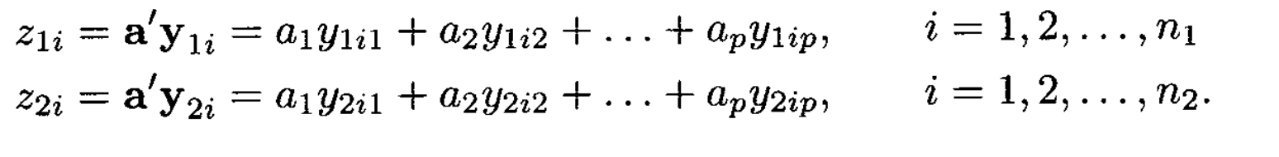
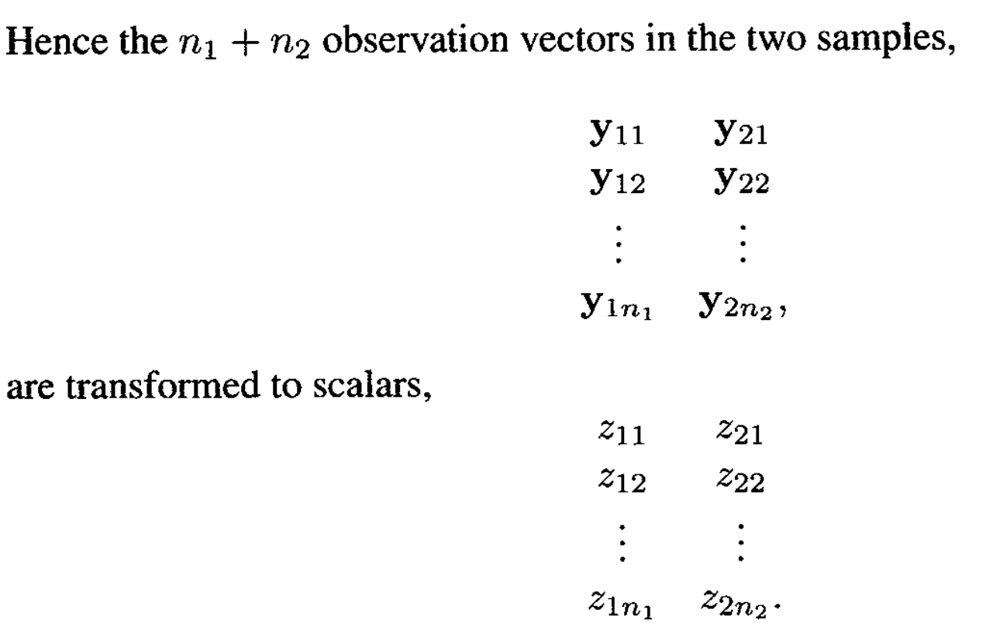
Discriminant function for two groups
Assume that the two populations to be compared have the same covariance matrix – but distinct mean vectors.

Slide 4
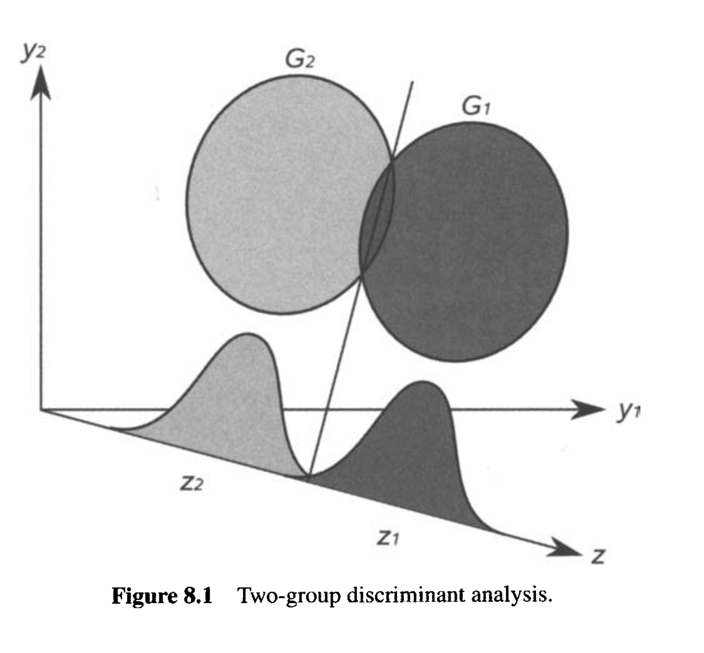

Slide 5
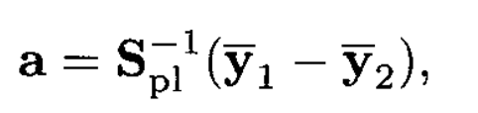
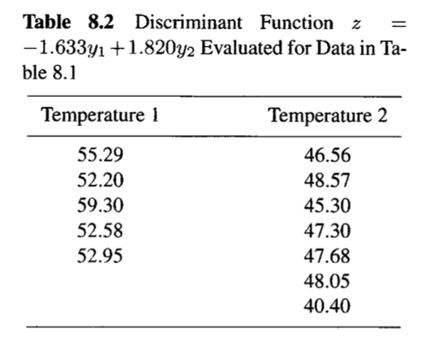
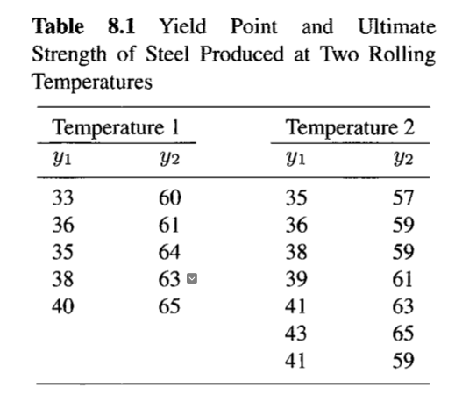
Separation is given by

Slide 6
Discriminant Analysis for Several groups
Extend previous idea to k groups
Examine group separation in a two-dimensional plot (we did this when we discussed clustering).
Find variables that best separate groups
Rank variables in terms of relative contribution
Interpret the new dimensions presented by the discriminate functions

Slide 7


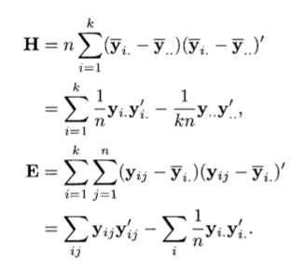

Slide 8

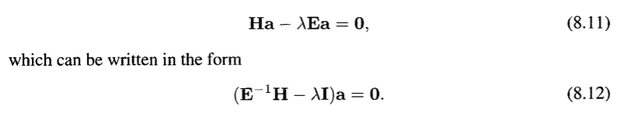
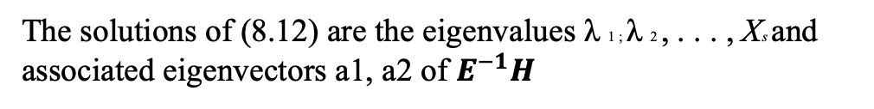
Continued
The solutions of (8.12) are the eigenvalues λ 1 ; λ 2 , . . . , Xs and associated eigenvectors a1, a2 of $E^{−1}H$

Slide 9
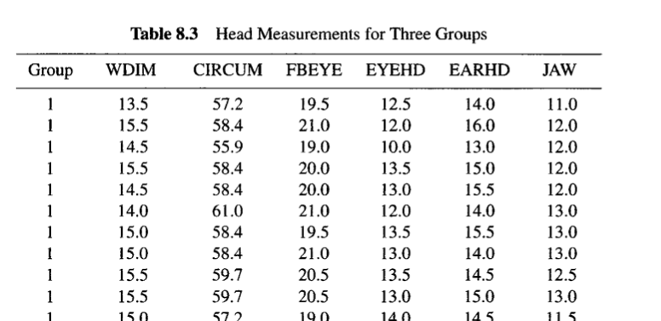
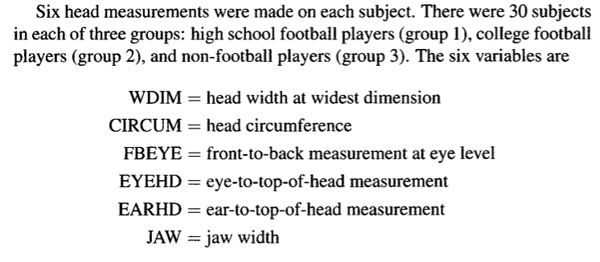
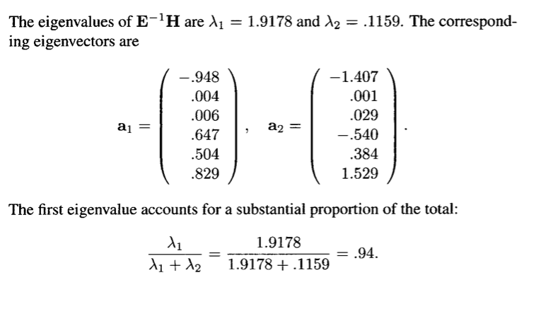

Slide 10

Measure of association for discriminant functions
It’s like an R squared value for the fit of discriminant functions

Slide 11
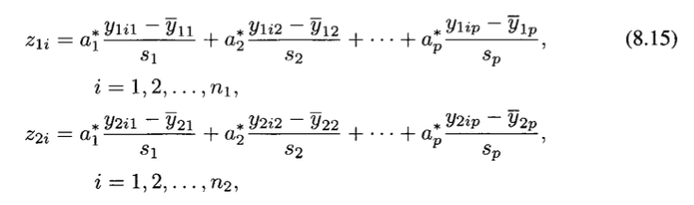
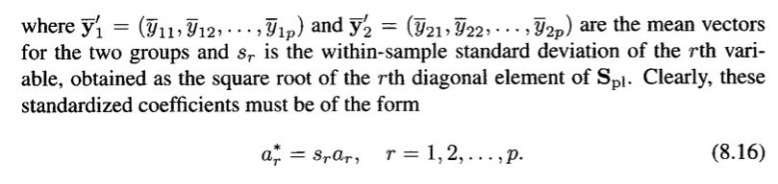

Standardized Discriminant Functions
Allows us to compare variable contributions

Slide 12

Tests of significance
In order to test hypotheses we need the assumption of multivariate normality
If the discriminant function coefficient vector a is significantly different from 0 then T^2 is significant.
If $α= \sum^{−1}{\left(μ_{1}−μ_{2}\right)}$, then $H_{0}:α=0$ is equivalent to $H_{0}:μ_{1}=μ_{2}$

Slide 13
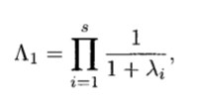

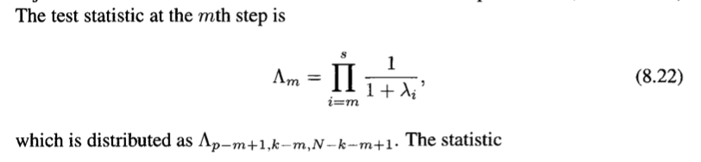

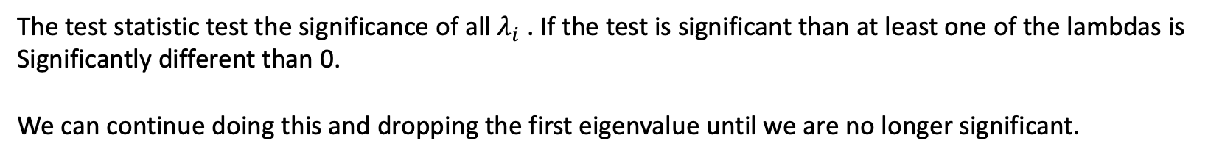

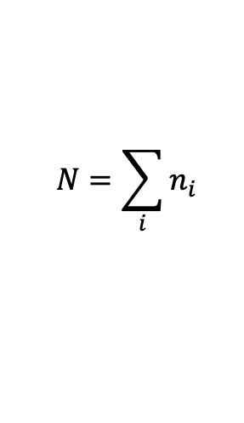
Tests for the several group case
$$N=\sum_{i}{n_{i}}$$
This is equivalent to Wilks’ $Λ$ test (see table A.9)
The test statistic test the significance of all $λ_{i}$ . If the test is significant than at least one of the lambdas is
Significantly different than 0.
We can continue doing this and dropping the first eigenvalue until we are no longer significant.

Slide 14
Interpretation of discriminant functions
Use standardized coefficients
Direction matters for interpretation – not contribution

Slide 15
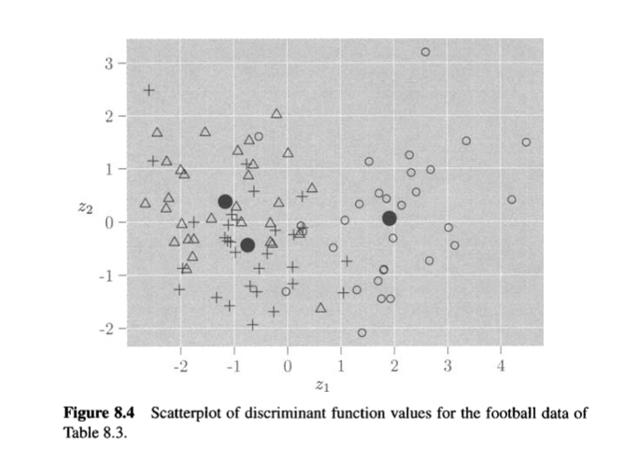
Scatter Plots

Slide 16
Chapter 9 Classification Analysis
Focus on predictive aspect of discriminant analysis. We started doing this in the previous section with graphs

Slide 17
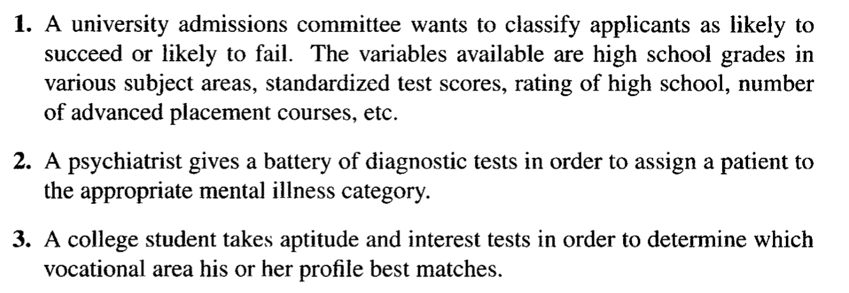
Examples

Slide 18
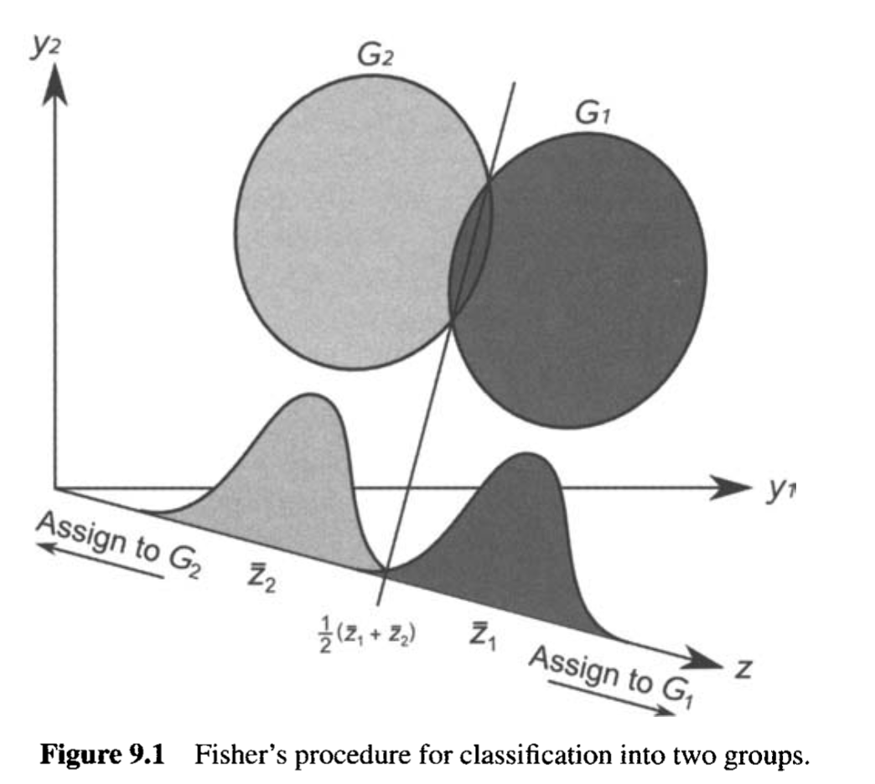
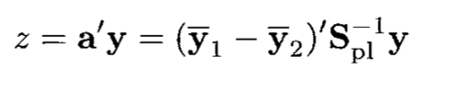
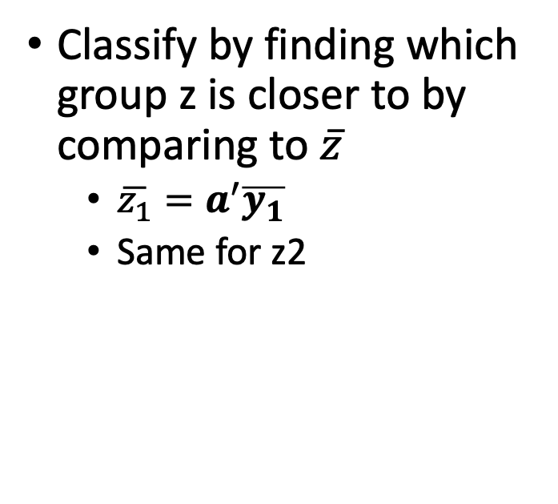
Classification in two groups
Classify by finding which group z is closer to by comparing to $\overline{z}$
$\overline{z_{1}}=a^{′}\overline{y_{1}}$
Same for z2

Slide 19
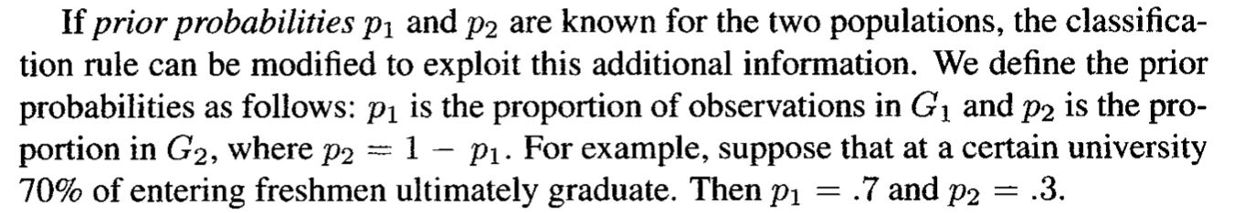
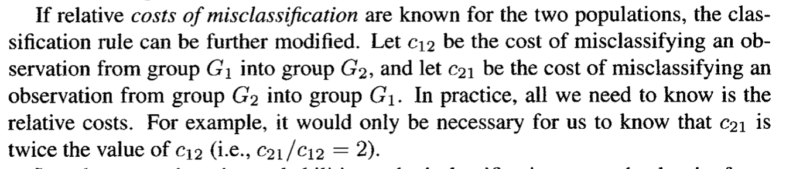
Prior probabilities

Slide 20
Optimal properties
Fisher’s Rule (if costs and priors are equal) is optimal under multivariate normal populations where the covariance matrix of the two groups is the same.

Slide 21


Classification into several groups
Assume equal misclassification costs
Assume equal covariance
Linear Classification function:
Add prior probabilities
Note that these coefficients are different than the LDA functions

Slide 22
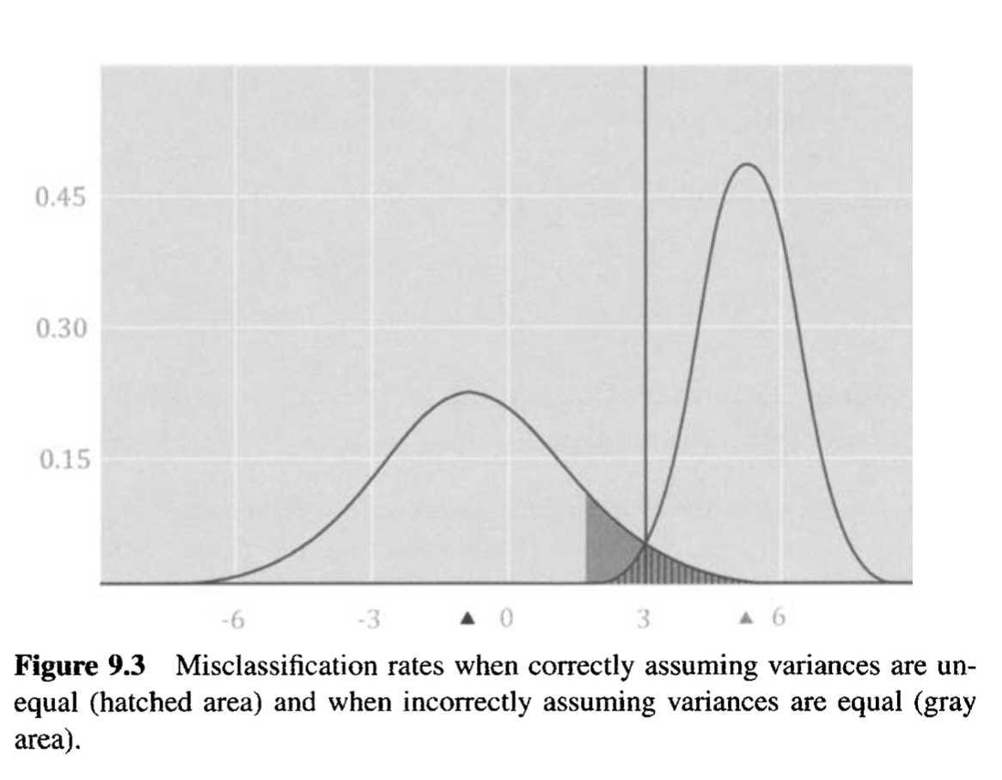

Unequal population covariance matrices: Quadratic Classification Functions
Not each n must be greater than p so that S may exist
for each group

Slide 23
Semester Overview
Linear Algebra, Visualization
Describing Multivariate Normal
Tests on one or two mean vectors
PCA
EFA/CFA
Clustering
Graphical
Discriminant Analysis
Are these two groups different?
Tests on one or two mean vectors
What describes the variation in the data?
PCA
What factors lead to the observed data
EFA/CFA
Can I make groups from the data?
Clustering
Graphical Analysis
Which features best separate the data? How well can I do it?
Discriminant Analysis

